Slide 1
Advanced Machine Learning
Lecture 1:
Intro: Two stories about data
Simple linear models
(based heavily on talks by Leon Bottou)

Slide 2
Story 1: The orbit of Mars
Suppose you are a person from ancient Greece, observing the night sky throughout the year.
In general, the stars are all moving in unison, as if they were attached to a big sphere that surrounds the Earth.
The Sun and the Moon are following nice trajectories relative to the stars. You could imagine that they were attached to spheres as well.
But the motion of the planets is pretty bizarre.
Mercury and Venus never go very far away from the Sun
Mars, Jupiter and Saturn follow very strange trajectories indeed.

Slide 3
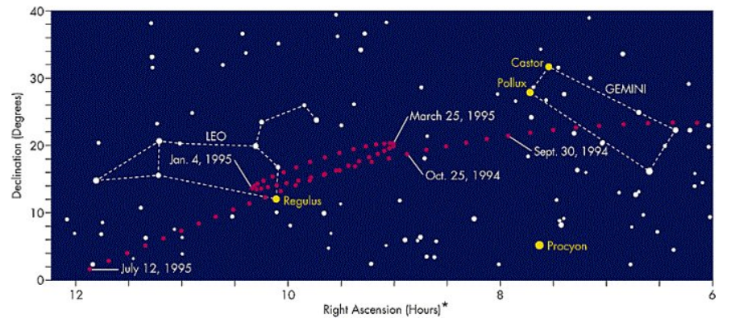
Story 1: Retrogade Motion
Mars moves in a very strange manner (Jupiter and Saturn do the same, but they take a lot longer to observe)

Slide 4
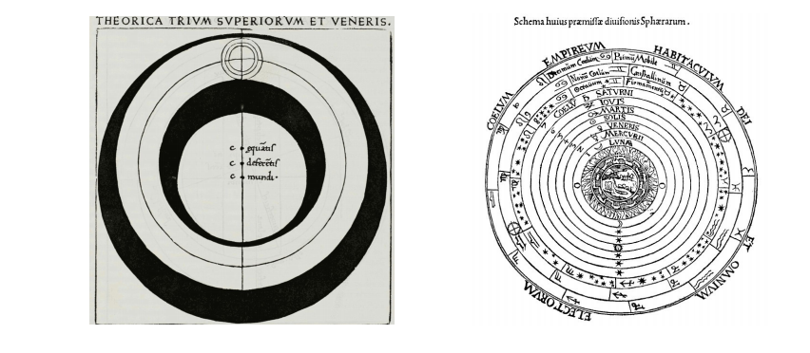
Story 1: Cycles and Epicycles
Aristotle (384-322 BC), Ptolemy (90-168 AD): used systems involving 53 to 55 concentric spheres.
Copernicus: puts the Sun in the center. Keeps the spheres.
Interestingly: observation tables were not accurate enough to distinguish which was the clearly better model.

Slide 5
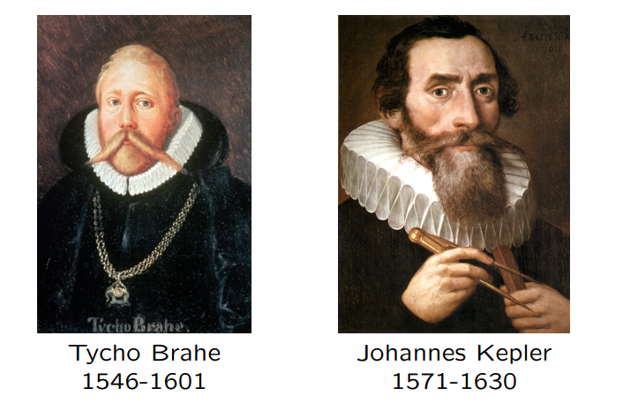
Story 1: The characters

Slide 6
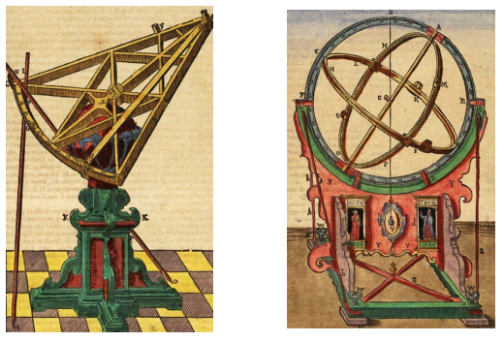
Story 1: Tycho’s Observatories
First in Uraniborg, then near Prague, thanks to a “grant” from emperor Rudolf II. There he hires a bright young assistant named Johannes Kepler.
Without a telescope, but with a modern approach to data collection:
daily observation of 1000 stars and 7 planets.
record positions with an accuracy of +/- 1’ of arc.

Slide 7
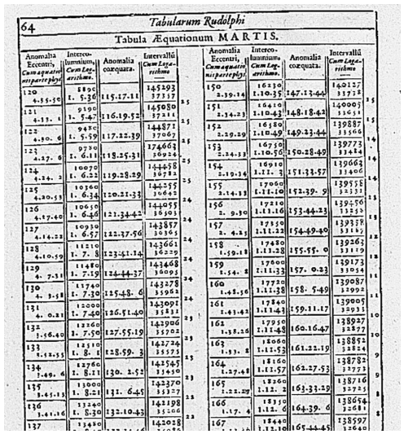
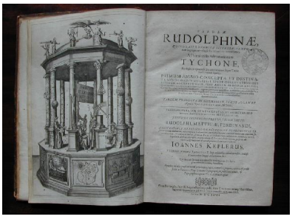
Story 1: The Rudolphine Tables
The Tabulae Rudolphinae were finally published by Kepler in 1627 under emperor Ferdinand.

Slide 8
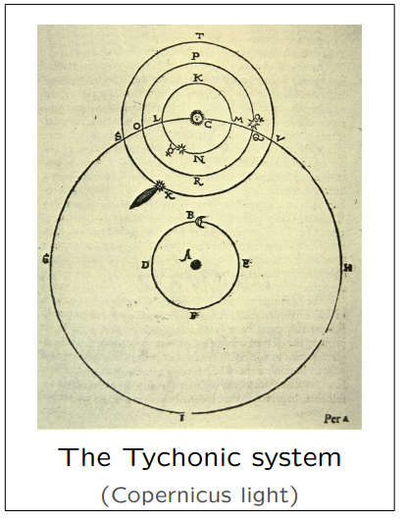
Story 1: The “War with Mars”
The first model of the orbit of Mars is developed, under Tycho’s direction. The average discrepancy was 2’, with a maximum discrepancy of 8’.
Kepler is unhappy with this model, he wants to go Copernican, but Tycho doesn’t like this.
Tycho dies in 1601.

Slide 9
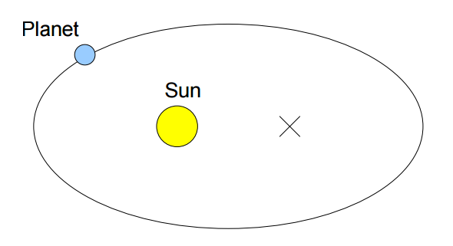
Story 1: First law of Kepler (1605)
The orbits of the planets are ellipses with the Sun at a focal point
(J. Kepler, Astronomia nova, 1609)

Slide 10
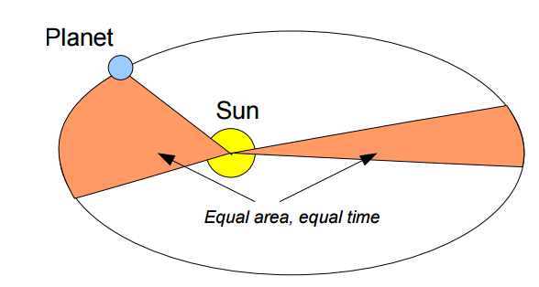
Story 1: Second law of Kepler (1609)
The line joining the planet to the Sun sweeps out equal areas in equal times as the planet travels around the ellipse.

Slide 11
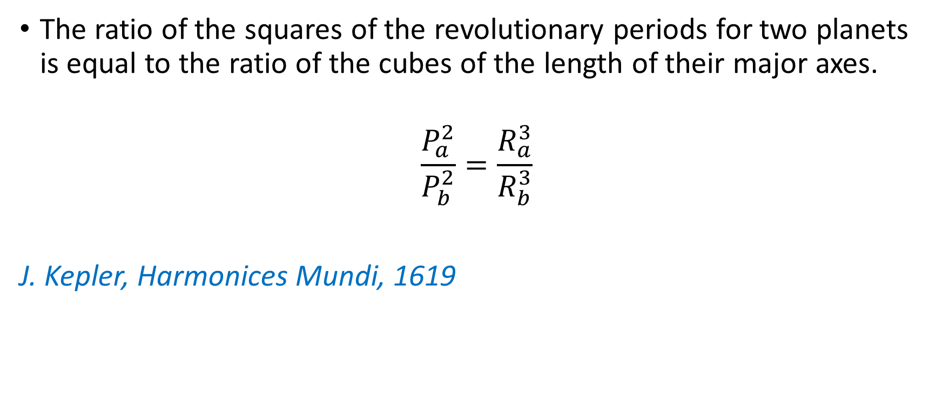
Story 1: Third law of Kepler (1619)
The ratio of the squares of the revolutionary periods for two planets is equal to the ratio of the cubes of the length of their major axes.
$$\frac{P_{a}^{2}}{P_{b}^{2}}=\frac{R_{a}^{3}}{R_{b}^{3}}$$
J. Kepler, Harmonices Mundi, 1619

Slide 12
Story 1: Validation
Kepler had it mostly right in 1605
Galileo points a telescope into the sky. He observes the phases of Venus with a telescope in 1610 and concludes that Venus orbits the Sun.
Newton publishes the Principia in 1687 and shows that the laws of Kepler (with a small correction) derive from his mechanics and from the idea of gravitation.

Slide 13
Story 1: Epilogue
This is about the foundation of the modern scientific approach. Let’s collect together the main themes:
Get the best data that you can.
Build models that fit the data as closely as possible.
Make sure that you get external validation.
validate with testing data set aside from the beginning.
validate using different datasets for the same problem.
and more generally, build a convincing story.

Slide 14
Story 2: The Cholera epidemic in London
London, circa 1854:
In the heart of the industrial revolution
Two million people
Insufficient sewage
Problems with garbage removal
Clean drinking water is a challenge.

Slide 15
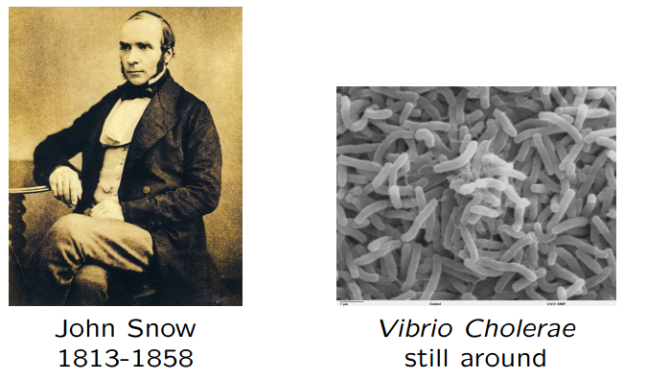
Story 2: The Characters
John Snow was a strong advocate of hygiene and anesthesia.

Slide 16
Story 2: The Outbreak
The most terrible outbreak of cholera which ever occurred in this kingdom, is probably that which took place in Broad Street, Golden Square, and the adjoining streets, a few weeks ago. Within two hundred and fifty yards of the spot where Cambridge Street joins Broad Street, there were upwards of five hundred fatal attacks of cholera in ten days. The mortality in this limited area probably equals any that was ever caused in this country, even by the plague, and it was much more sudden, as the greater number of cases terminated in a few hours.
- John Snow, On the mode of communication of cholera, 1854.

Slide 17
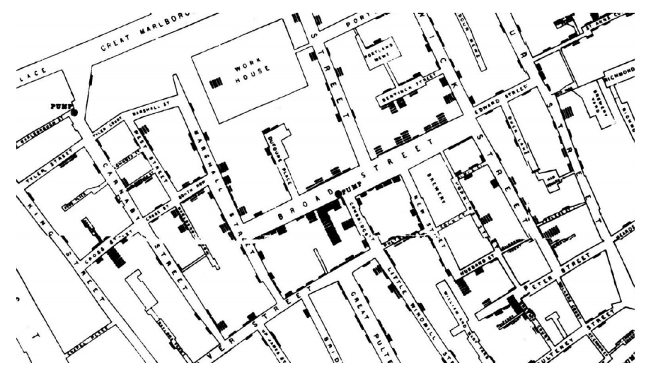
Story 2: The Map

Slide 18
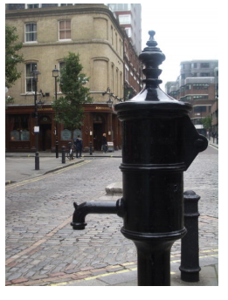
Story 2: The Broad Street Pump
On proceeding to the spot, I found that nearly all the deaths had taken place within a short distance of the [Broad Street] pump. There were only ten deaths in houses situated decidedly nearer to another street-pump. In five of these cases the families of the deceased persons informed me that they always sent to the pump in Broad Street, as they preferred the water to that of the pumps which were nearer. In three other cases, the deceased were children who went to school near the pump in Broad Street. . .
- John Snow, On the mode of communication of cholera, 1854.

Slide 19
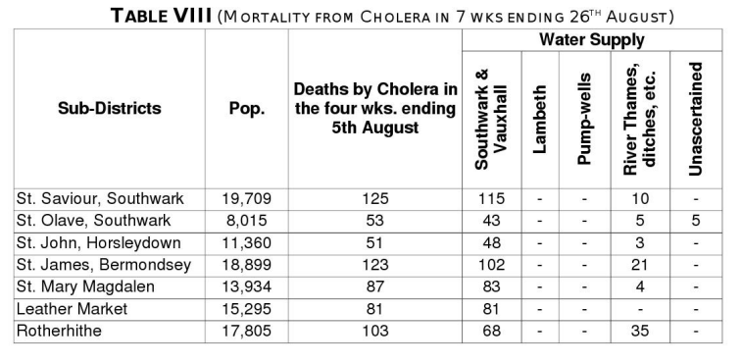
Story 2: Epidemiology and Statistics
Snow uses simple statistics to confirm the role of impure water.

Slide 20
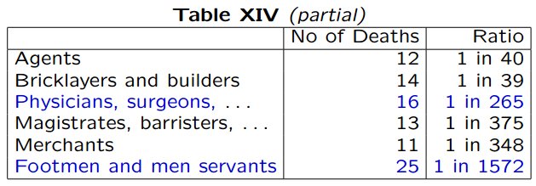
Story 2: Epidemiology and Statistics
Snow uses simple statistics to invalidate competing hypotheses
If cholera was propagated by effluvia from sick people, then:
Why are physicians less affected than their patients?
Why are men servants less affected than their masters?
Why are master brewers virtually immune?

Slide 21
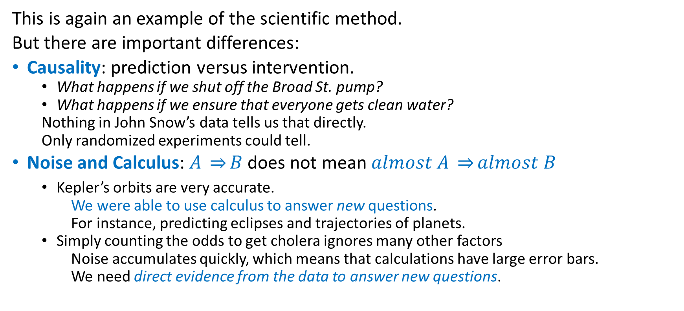
Story 2: Epilogue
This is again an example of the scientific method.
But there are important differences:
Causality: prediction versus intervention.
What happens if we shut off the Broad St. pump?
What happens if we ensure that everyone gets clean water?
Nothing in John Snow’s data tells us that directly.
Only randomized experiments could tell.
Noise and Calculus: $A \overset{⇒}{}B$does not mean $almost A \overset{⇒}{}almost B$
Kepler’s orbits are very accurate.
We were able to use calculus to answer new questions.
For instance, predicting eclipses and trajectories of planets.
Simply counting the odds to get cholera ignores many other factors
Noise accumulates quickly, which means that calculations have large error bars.
We need direct evidence from the data to answer new questions.

Slide 22
Why are these stories relevant?
Fundamental problem is one of needing to think thru the data, and figure out how to apply the scientific method rigorously.
Computers do not change the problems, they change the scale of the problems.
but
What is a minor problem with small scale data can turn into a formidable problem with large scale data.

Slide 23
The Course
Goals:
Learn selected theoretical tools
Learn selected practical approaches
Acquire experience with several kinds of data
Acquire the right attitude.
Topics
Classification, Clustering, Statistics,
Exploratory methods, Applications…

Slide 24
Part 2: Simple Linear Models
Linear Regression with numpy

Slide 25
Introduction
Useful things:
understanding probabilities
understanding statistical learning theory
knowing countless statistical procedures
knowing countless machine learning algorithms
Essential things:
applying common sense
paying attention to details
being able to setup experiments
being able to measure the outcome of experiments
being able to measure plenty of other things

Slide 26
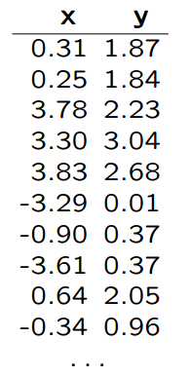

Connecting the dots
Question: Find $y$ given $x$:

Slide 27
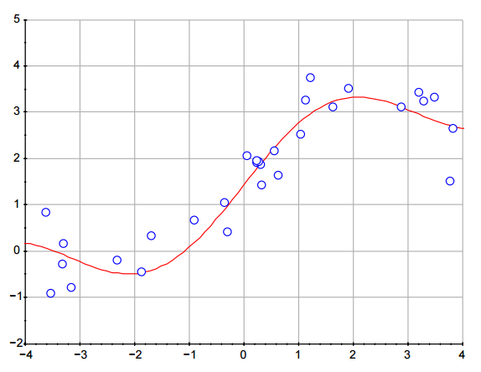
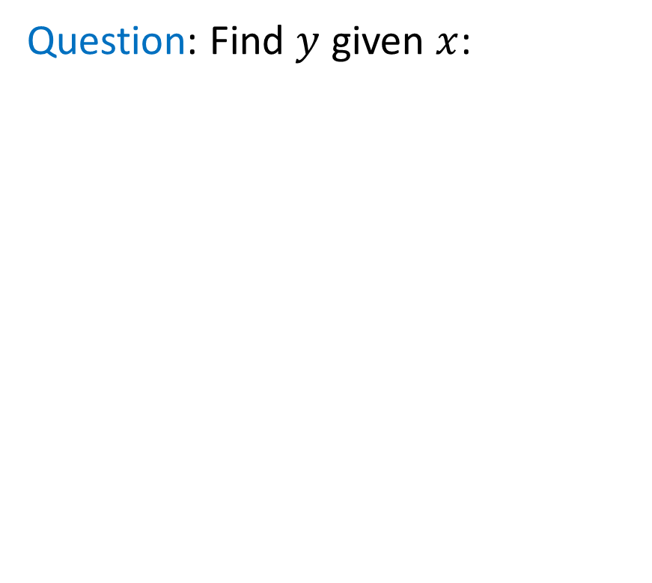
Connecting the dots
Question: Find $y$ given $x$:
Answer: Connect the dots. Read the curve.

Slide 28
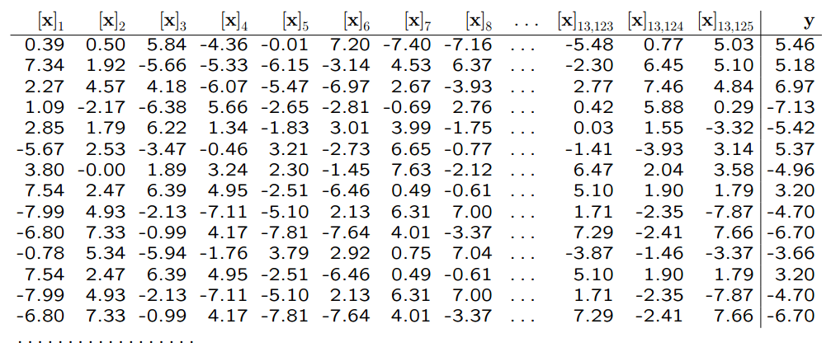
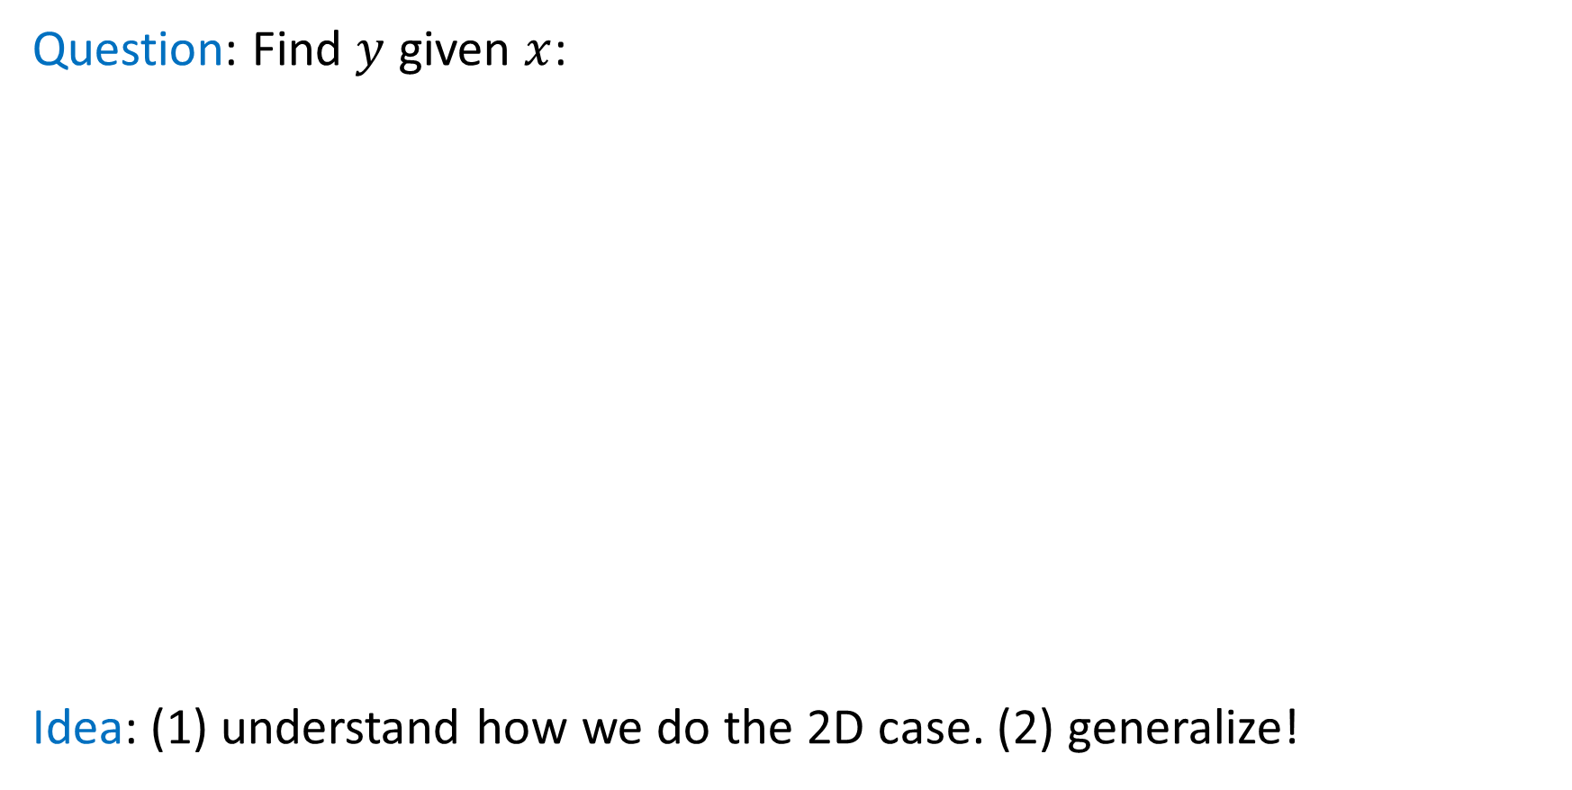
Connecting the dots, take two
Question: Find $y$ given $x$:
Idea: (1) understand how we do the 2D case. (2) generalize!

Slide 29
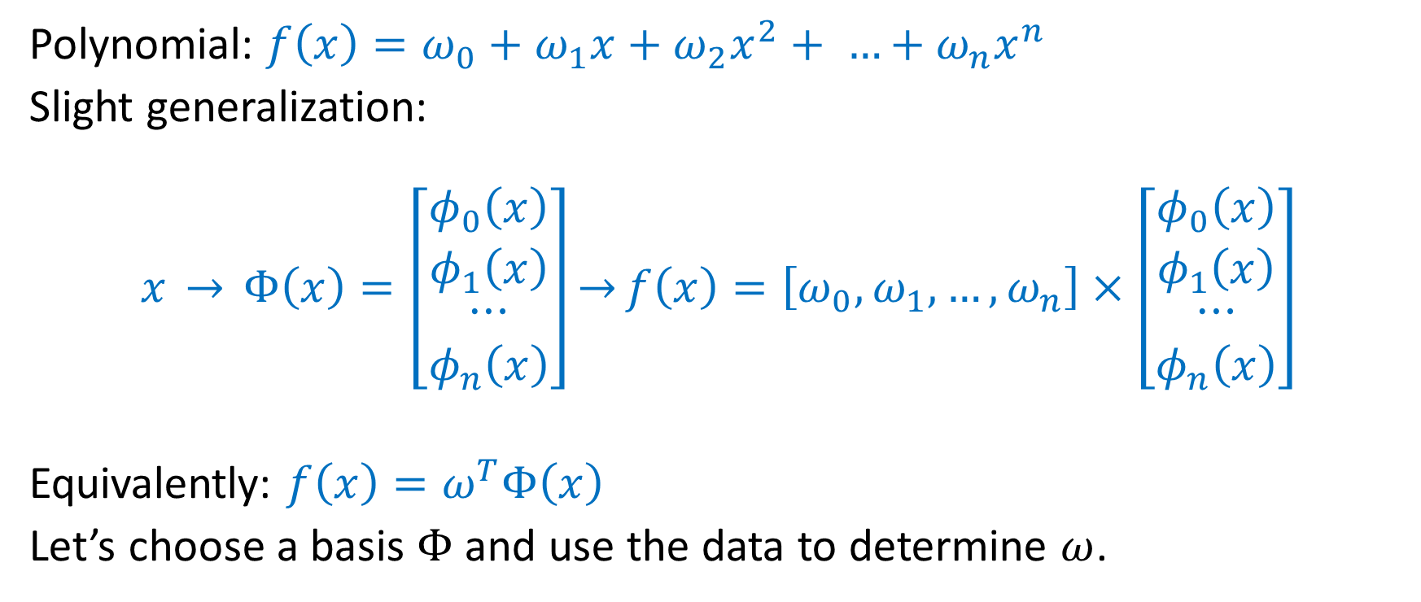
A Simple Linear Model
Polynomial: $f\left(x\right)=ω_{0}+ω_{1}x+ω_{2}x^{2}+ …+ω_{n}x^{n}$
Slight generalization:
$$x \overset{→}{} Φ\left(x\right)=\left[\begin{matrix}φ_{0}\left(x\right) \\ φ_{1}\left(x\right) \\ \begin{matrix}⋯ \\ φ_{n}\left(x\right)\end{matrix}\end{matrix}\right]\overset{→}{}f\left(x\right)=\left[ω_{0}, ω_{1}, …, ω_{n}\right]×\left[\begin{matrix}φ_{0}\left(x\right) \\ φ_{1}\left(x\right) \\ \begin{matrix}⋯ \\ φ_{n}\left(x\right)\end{matrix}\end{matrix}\right]$$
Equivalently: $f\left(x\right)=ω^{T}Φ\left(x\right)$
Let’s choose a basis $Φ$ and use the data to determine $ω$.

Slide 30
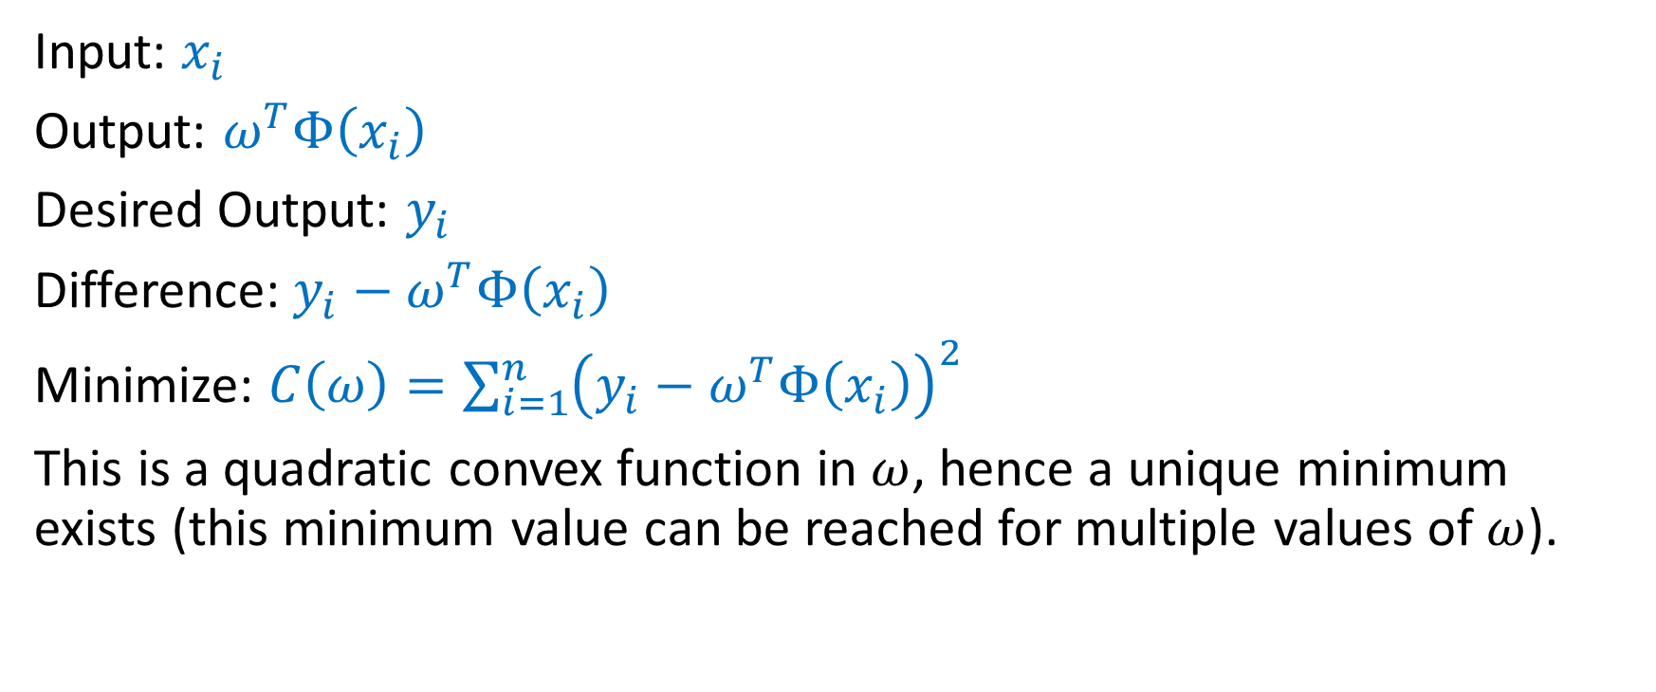
Linear Least Squares
Input: $x_{i}$
Output: $ω^{T}Φ\left(x_{i}\right)$
Desired Output: $y_{i}$
Difference: ${y_{i}−ω}^{T}Φ\left(x_{i}\right)$
Minimize: $C\left(ω\right)=\sum_{i=1}^{n}{{\left({y_{i}−ω}^{T}Φ\left(x_{i}\right)\right)}^{2}}$
This is a quadratic convex function in $ω$, hence a unique minimum exists (this minimum value can be reached for multiple values of $ω$).

Slide 31
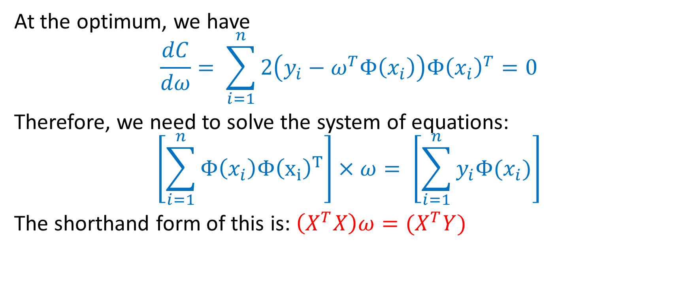
A little bit of Linear Algebra
At the optimum, we have
$$\frac{dC}{dω}= \sum_{i=1}^{n}{2\left(y_{i}−ω^{T}Φ\left(x_{i}\right)\right)Φ{\left(x_{i}\right)}^{T}=0}$$
Therefore, we need to solve the system of equations:
$$\left[\sum_{i=1}^{n}{Φ\left(x_{i}\right)Φ{\left(x_{i}\right)}^{T}}\right]×ω= \left[\sum_{i=1}^{n}{y_{i}Φ(x_{i})}\right]$$
The shorthand form of this is: $\left(X^{T}X\right)ω=(X^{T}Y)$

Slide 32
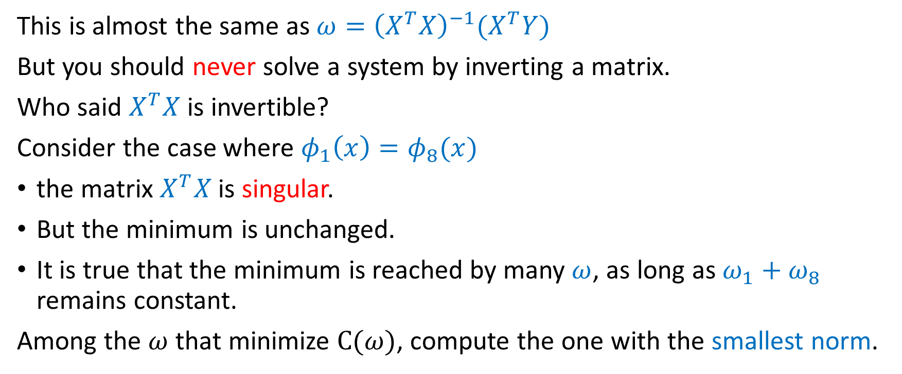
Singularities
This is almost the same as $ω={\left(X^{T}X\right)}^{−1}(X^{T}Y)$
But you should never solve a system by inverting a matrix.
Who said $X^{T}X$ is invertible?
Consider the case where $φ_{1}\left(x\right)=φ_{8}(x)$
the matrix $X^{T}X$ is singular.
But the minimum is unchanged.
It is true that the minimum is reached by many $ω$, as long as $ω_{1}+ω_{8}$ remains constant.
Among the $ω$ that minimize $C(ω)$, compute the one with the smallest norm.

Slide 33
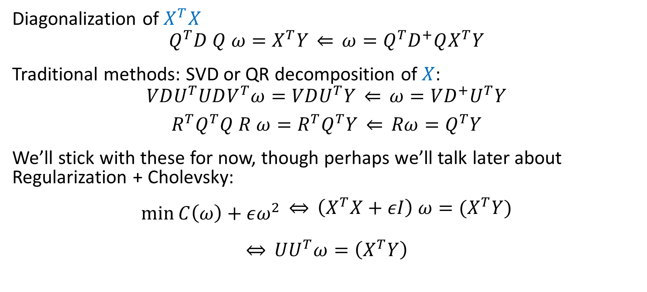
Solving the equation without inverting
Diagonalization of $X^{T}X$
$$Q^{T}D Q ω=X^{T}Y \overset{⇐}{} ω=Q^{T}D^{+}QX^{T}Y$$
Traditional methods: SVD or QR decomposition of $X$:
$$VDU^{T}UDV^{T}ω=VDU^{T}Y \overset{⇐}{} ω=VD^{+}U^{T}Y$$
$$R^{T}Q^{T}Q R ω=R^{T}Q^{T}Y \overset{⇐}{} Rω=Q^{T}Y$$
We’ll stick with these for now, though perhaps we’ll talk later about Regularization + Cholevsky:
$$\min_{}{C\left(ω\right)+εω^{2}}{\begin{aligned} \underset{⇔}{} \left(X^{T}X+εI\right) ω=(X^{T}Y) \\ \end{aligned}}$$
$$\overset{⇔}{} UU^{T}ω=\left(X^{T}Y\right)$$

Slide 34
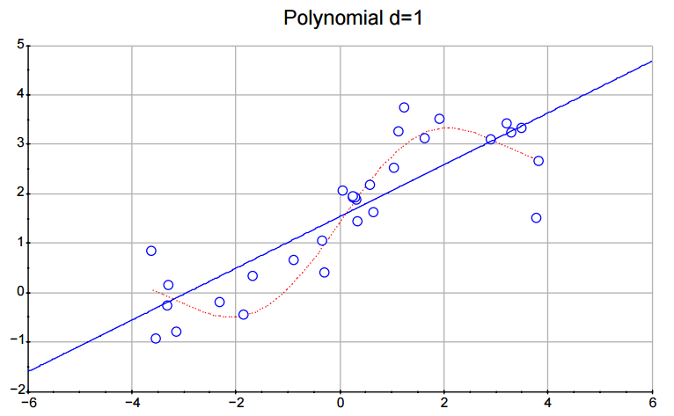
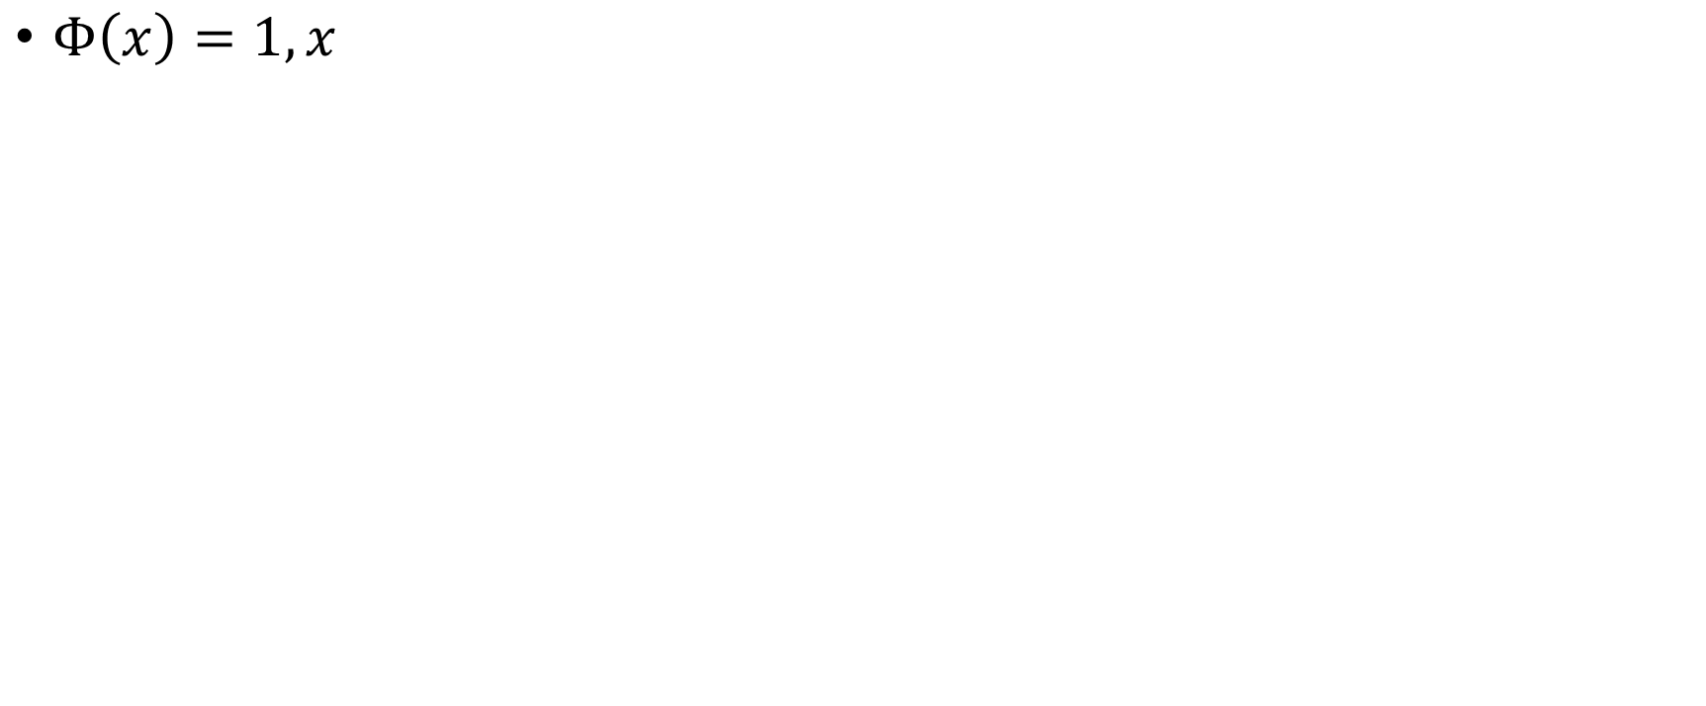
Polynomial degree 1
$Φ\left(x\right)=1, x$

Slide 35
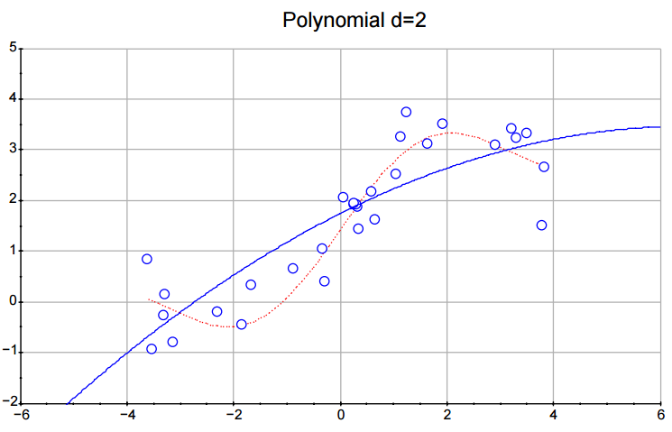
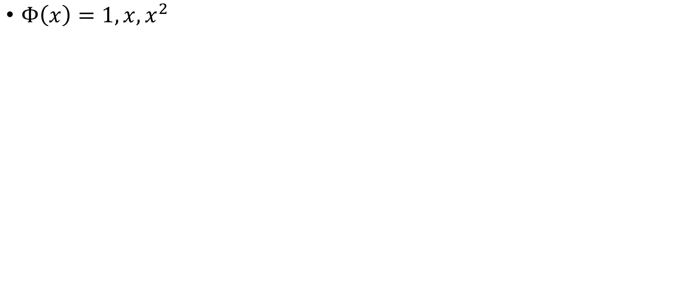
Polynomial degree 2
$Φ\left(x\right)=1, x, x^{2}$

Slide 36
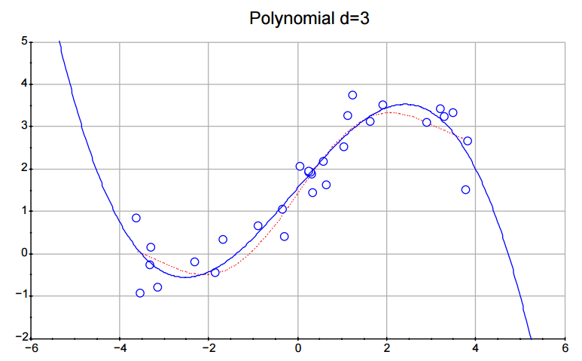
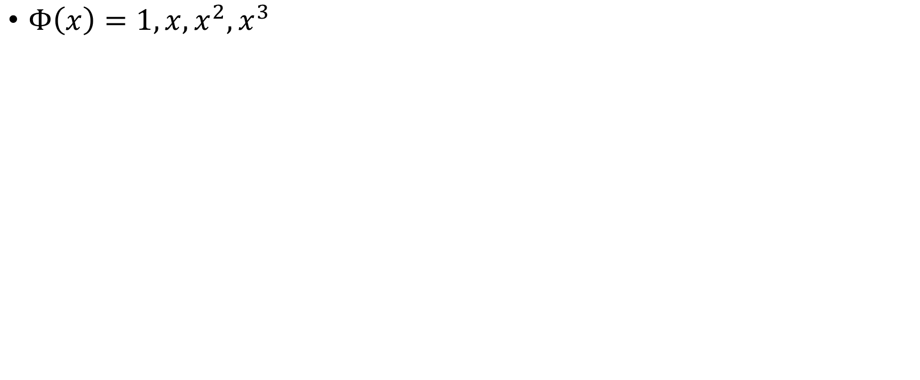
Polynomial degree 3
$Φ\left(x\right)=1, x, x^{2}, x^{3}$

Slide 37
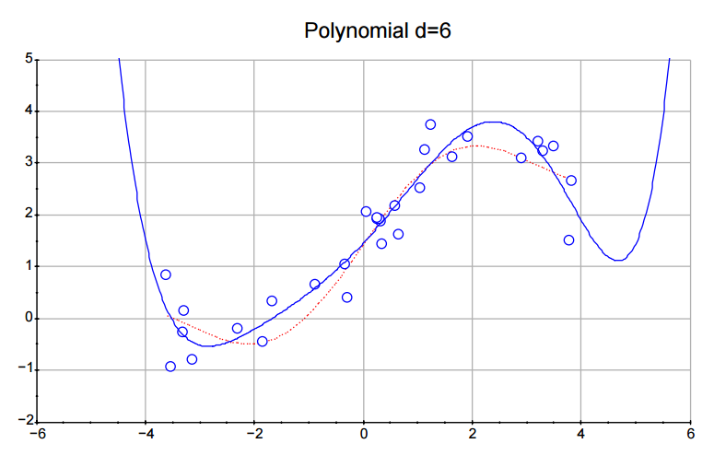
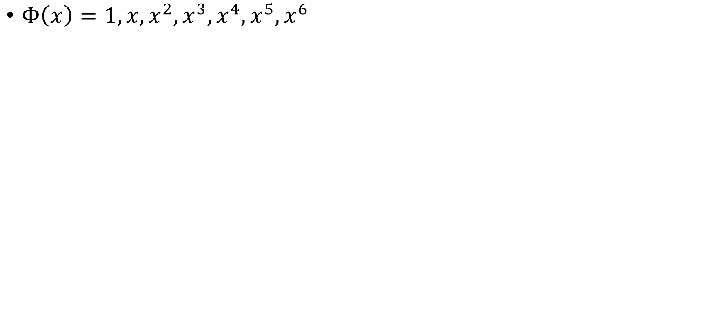
Polynomial degree 6
$Φ\left(x\right)=1, x, x^{2}, x^{3}, x^{4},x^{5},x^{6}$

Slide 38
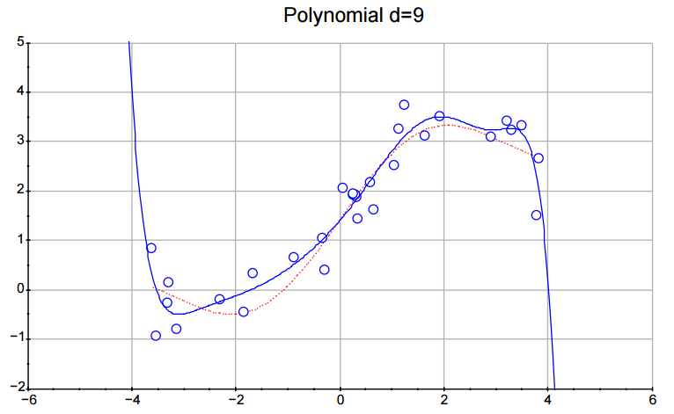
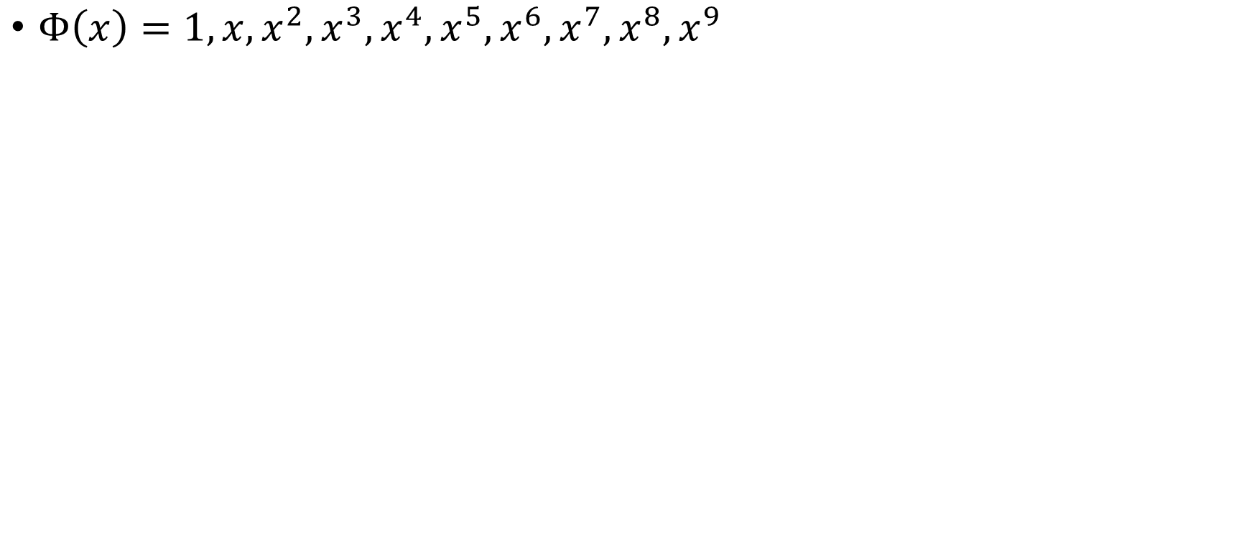
Polynomial degree 9
$Φ\left(x\right)=1, x, x^{2}, x^{3}, x^{4},x^{5},x^{6}, x^{7},x^{8},x^{9}$

Slide 39
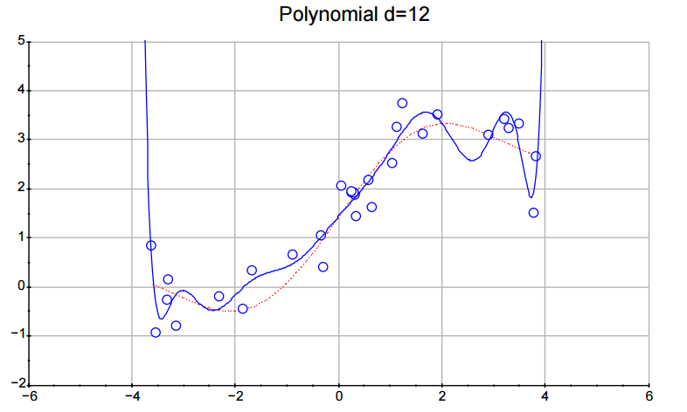
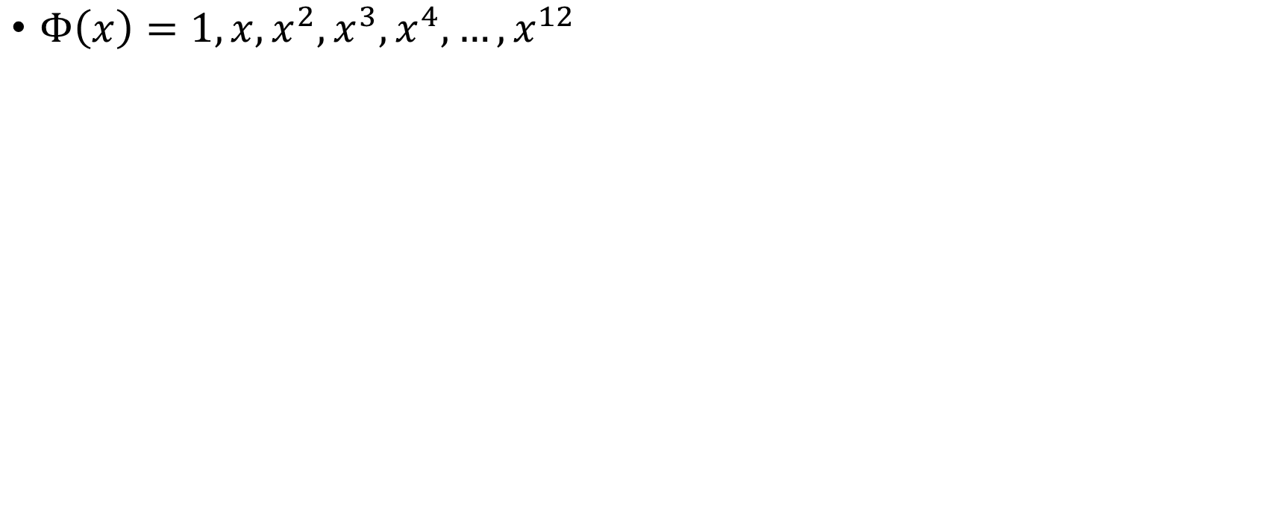
Polynomial degree 12
$Φ\left(x\right)=1, x, x^{2}, x^{3}, x^{4},…,x^{12}$

Slide 40
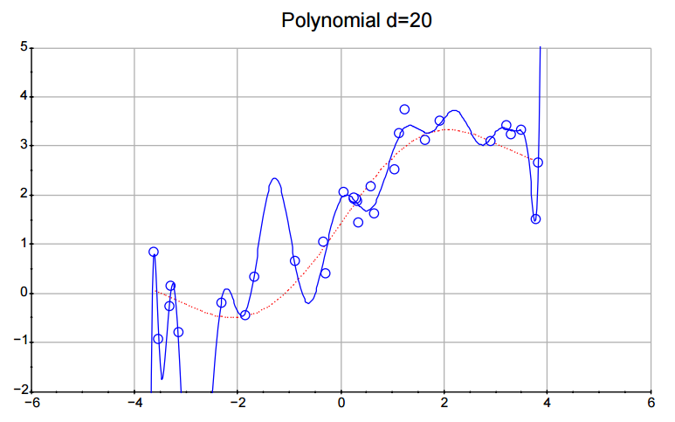
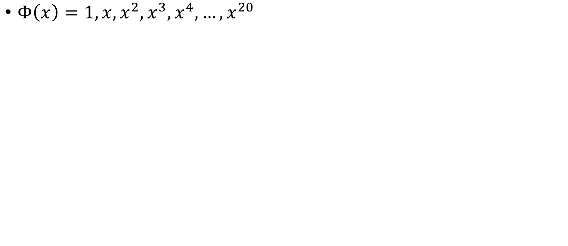
Polynomial degree 20
$Φ\left(x\right)=1, x, x^{2}, x^{3}, x^{4},…,x^{20}$

Slide 41
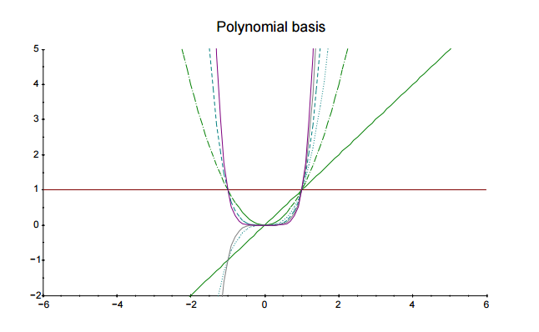
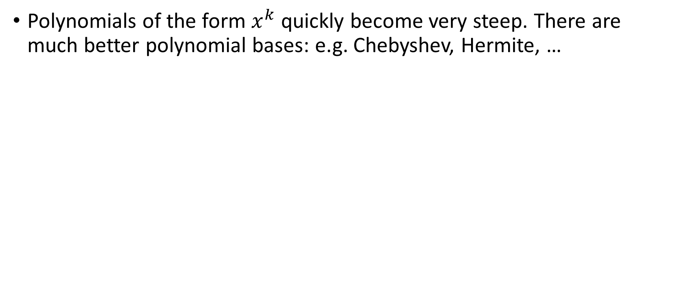
Polynomial Basis
Polynomials of the form $x^{k}$ quickly become very steep. There are much better polynomial bases: e.g. Chebyshev, Hermite, …

Slide 42
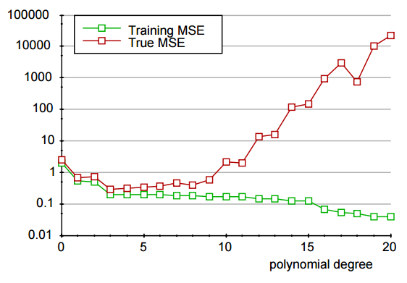
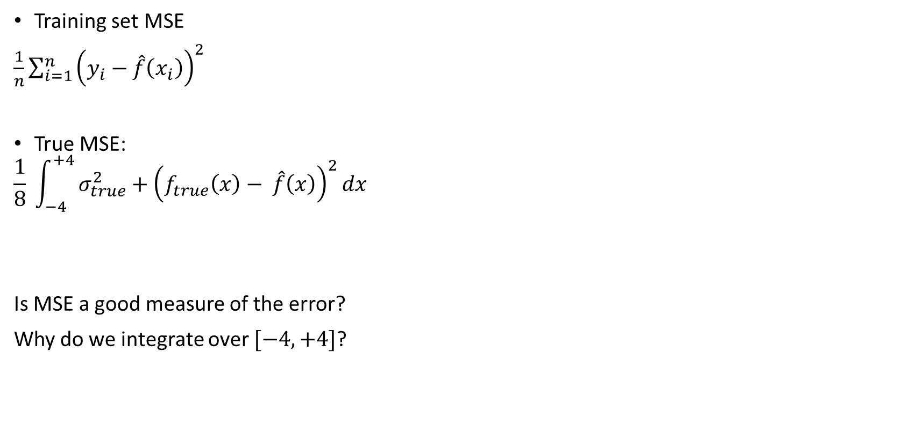
Mean squared error for polynomial models
Training set MSE
$\frac{1}{n}\sum_{i=1}^{n}{{\left(y_{i}−\hat{f}\left(x_{i}\right)\right)}^{2}}$
True MSE:
$$\frac{1}{8} \int_{−4}^{+4}{σ_{true}^{2}+{\left(f_{true}\left(x\right)− \hat{f}\left(x\right)\right)}^{2}dx}$$
Is MSE a good measure of the error?
Why do we integrate over $[−4,+4]$?

Slide 43
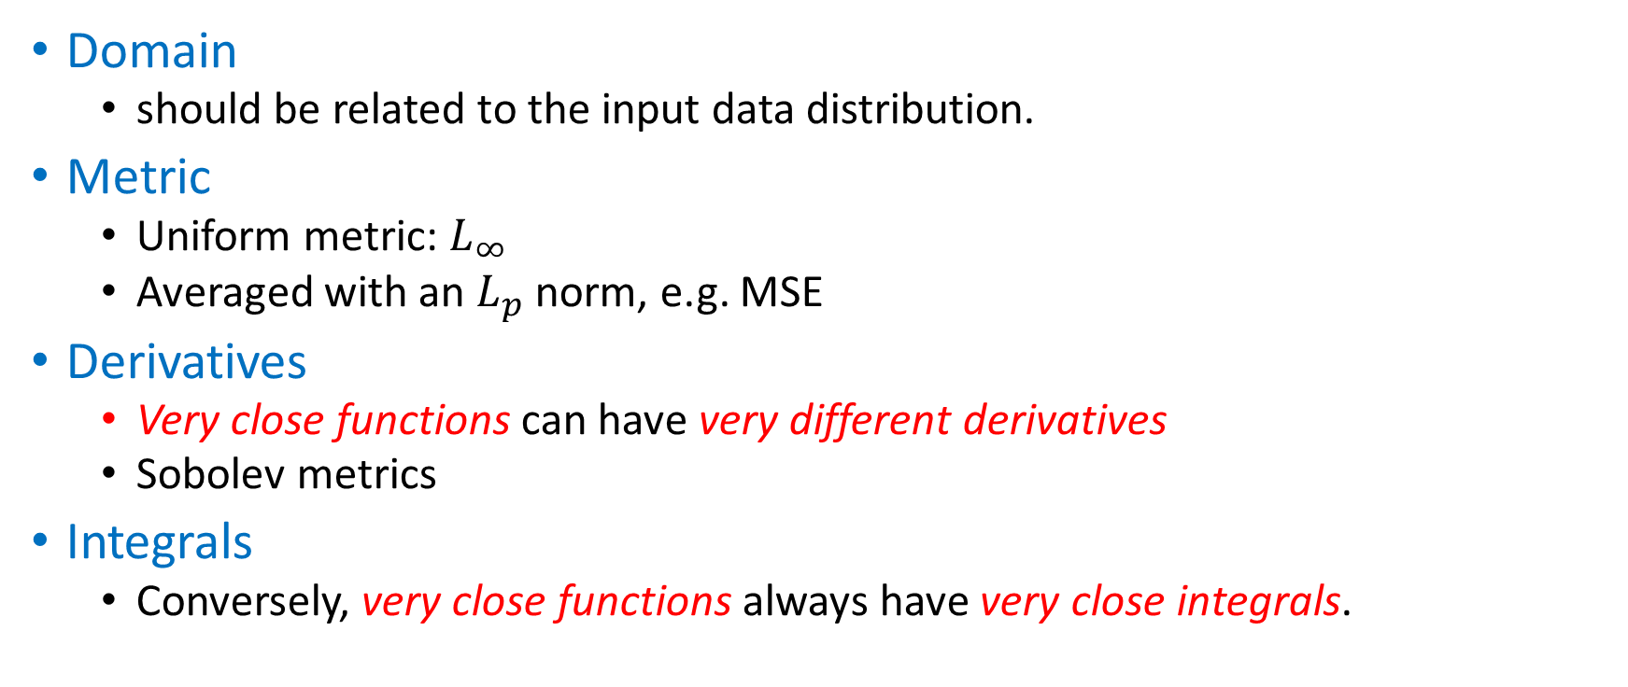
About Error Measures
Domain
should be related to the input data distribution.
Metric
Uniform metric: $L_{∞}$
Averaged with an $L_{p}$ norm, e.g. MSE
Derivatives
Very close functions can have very different derivatives
Sobolev metrics
Integrals
Conversely, very close functions always have very close integrals.

Slide 44
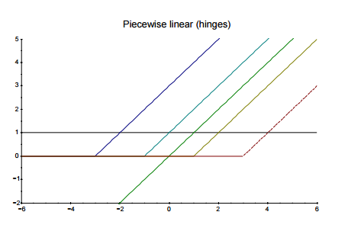
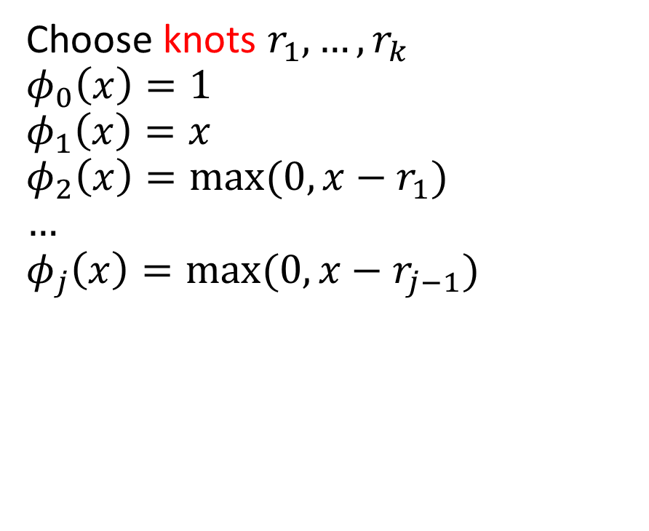
Piecewise Linear Basis
Choose knots $r_{1},…, r_{k}$
$$φ_{0}\left(x\right)=1$$
$$φ_{1}\left(x\right)=x$$
$$φ_{2}\left(x\right)=max⁡(0,x−r_{1})$$
$$…$$
$$φ_{j}\left(x\right)=max⁡(0, x−r_{j−1})$$

Slide 45
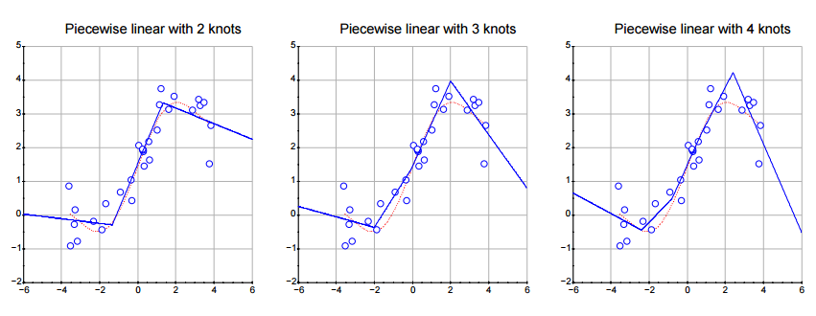
Piecewise Linear Models

Slide 46
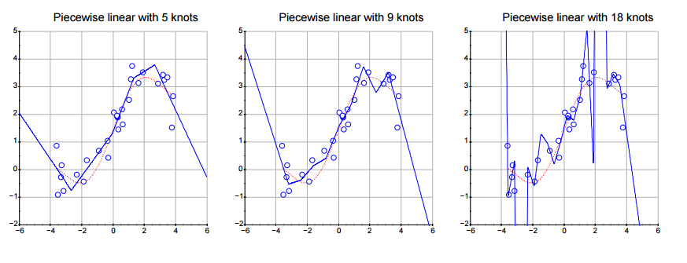
Piecewise Linear Models

Slide 48
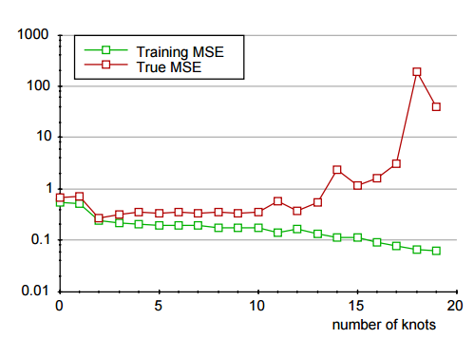

MSE for Piecewise Linear Models
Training set MSE:
$$\frac{1}{n}\sum_{i=1}^{n}{(y_{i}− \hat{f}}{\left(x_{i})\right)}^{2}$$
True MSE:
$$\frac{1}{8} \int_{−4}^{4}{σ_{true}^{2}+{\left(f_{true}\left(x\right)− \hat{f}\left(x\right)\right)}^{2}dx }$$

Slide 49


Piecewise Polynomial (Splines)
Quadratic splines: $Φ\left(x\right)=1, x, x^{2},…,{\max\left(0, x−r_{k}\right)}^{2}, …$
Cubic splines: $Φ\left(x\right)=1, x, x^{2},x^{3}, …,{\max\left(0, x−r_{k}\right)}^{3}, …$

Slide 50


MSE for Quadratic Splines
Training set MSE:
$$\frac{1}{n}\sum_{i=1}^{n}{(y_{i}− \hat{f}}{\left(x_{i})\right)}^{2}$$
True MSE:
$$\frac{1}{8} \int_{−4}^{4}{σ_{true}^{2}+{\left(f_{true}\left(x\right)− \hat{f}\left(x\right)\right)}^{2}dx }$$

Slide 51

Changing the training data: more examples

Slide 52

Changing the training data: less noise

Slide 53
First Conclusions
The fancier the models, the higher the price.
We can pay with more data.
We can pay with better data.
In practice we do the converse.
Changing the data is usually more costly than changing the model.
Adapt the model “capacity” to the data.
No shortage of methods.
The validation questions.
We have too many options. How to choose one?
How to estimate the quality of our work?

Slide 54
Estimate the quality of our work
Performance on the training data is not convincing
Cannot distinguish between learning by rote and understanding.
Understanding leads to more useful predictions than learning by rote.
Therefore we need fresh data to evaluate our work.
Testing examples set aside before starting the work.
Statistics work for randomly picked testing examples.
Real life suggests selected testing examples (e.g. time series.)
Testing data of a different nature.
New perspective on the same phenomenon.
Often more instructive and convincing.
What about the “elegance” of a model ?
Einstein:“Make everything as simple as possible, but not simpler.”
How do you define “simple” ?

